Slide 1
NASH
EQUILIBRIUM
by Khairudinov Mykyta
National technical university of Ukraine “KPI”

Slide 2
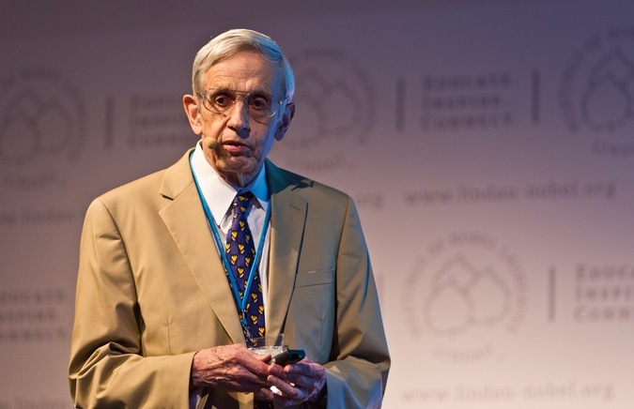
John Forbes Nash

Slide 3
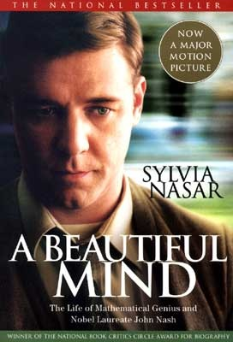
Nash is known to the general audience and
to non-economists through the book
of a student who has been inspired by his exiting life. “The Beautiful Mind” is a film, which won 4 Oscars , and is based exactly on this book.

Slide 4
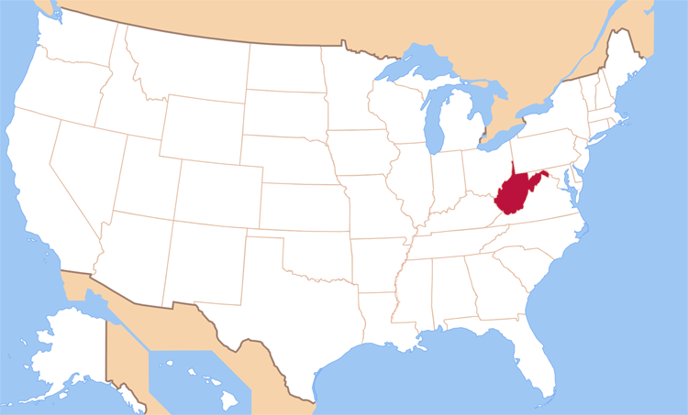
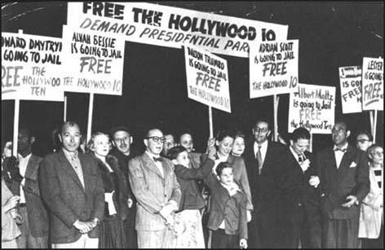
John Nash was born in the midst
of economic crisis, in 1928 in the
tiny town Bluefield, West Virginia.
When John was 14, he read a book
“Men of Mathematics” by
Eric Temple Bell and without any
help proved the Fermat's little theorem.

Slide 5
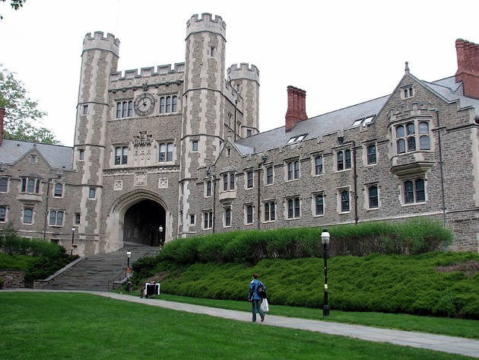
Nash went to Princeton University. There he got to know the Games Theory, and later he got a Nobel Prize for working with it.

Slide 6
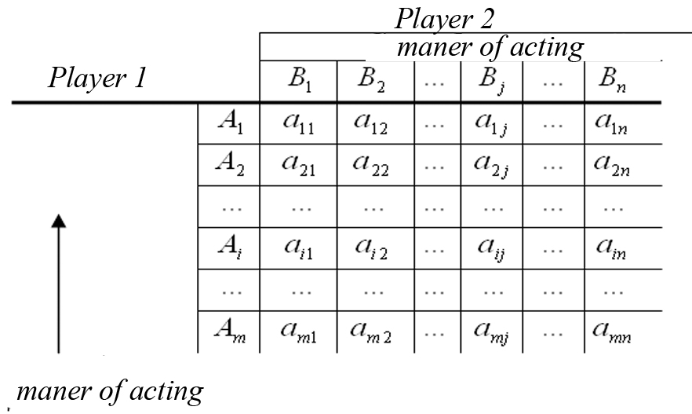
The Games Theory is a mathematical method of optimal strategies analysis in games.
A game is a process between two or more people, who uphold their own interests.

Slide 7
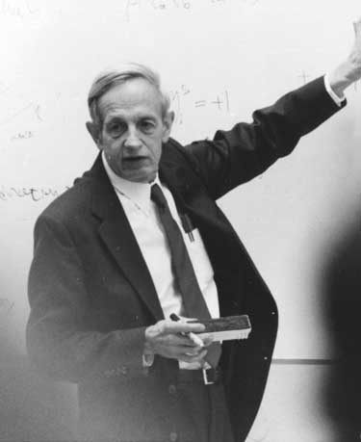
Nash got a new method of how to resolve this problem: no one can win changing their own decision if other players do not change their ones.

Slide 8
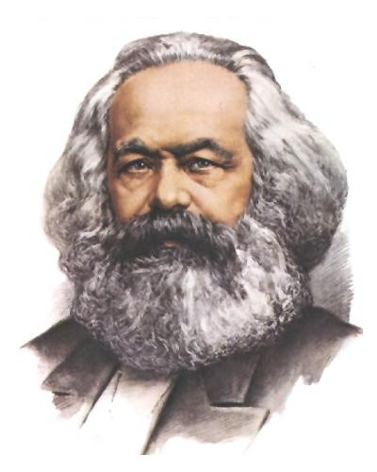
Nash’s works mathematically prove Karl Marx’s labour theory of value, which was banned in the USA that time. The government started to be interested in Nash. Later he got recruited by RAND – national safety organization. There John worked with the government and used his theory of games for waging cold war between the USA and the USSR.

Slide 9
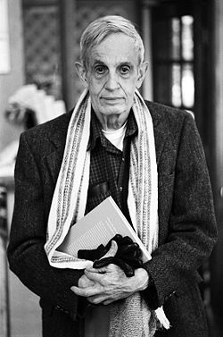
When he was 30 years old, he got seek. Paranoia (paranoid schizophrenia) is a difficult illness and Nash fated to live with it for the rest of his life. He couldn’t recover but he learnt how to live with it.

Slide 10
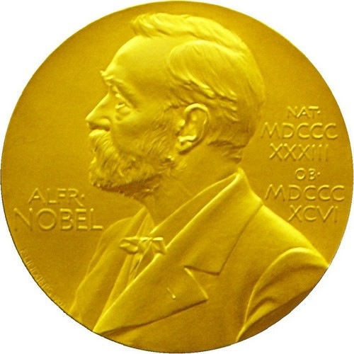
He came to stay in economics world and in 1994 Nash got a Nobel Prize for researching in non-cooperative games.

Slide 11
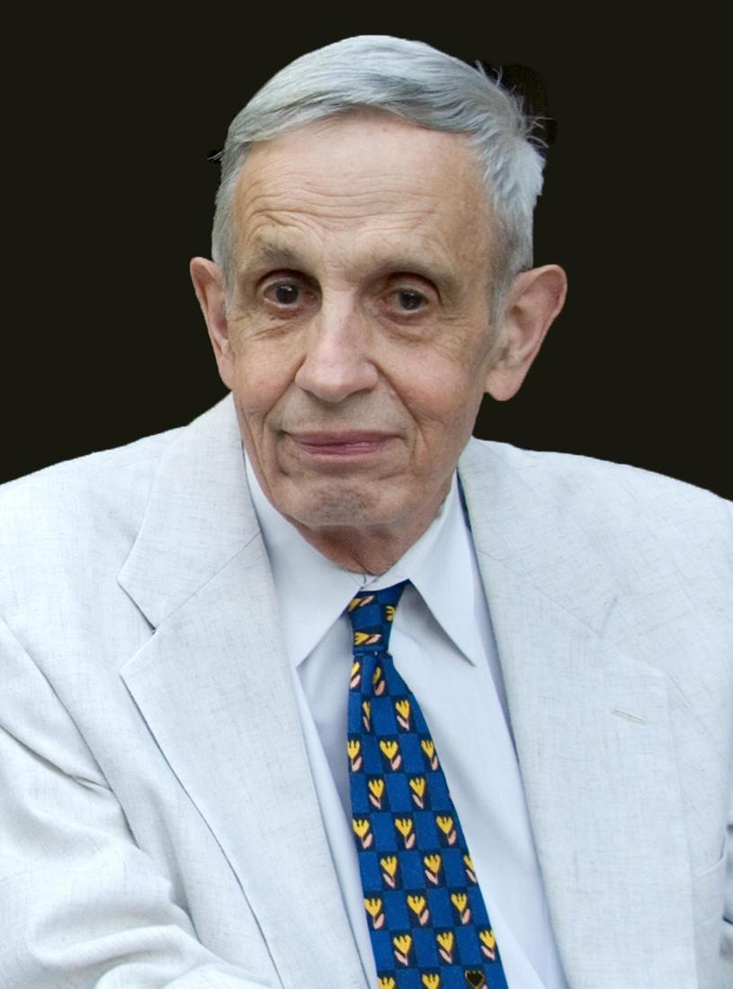
It is impossible to overestimate his contribution to modern economics. Nash’s life has inspirited a lot of young economists and scientists, and continues doing it.

Slide 12
Thank you for your attention!

