Slide 1
Monetarism

Slide 2
Economics
?

Slide 3
economics
micro
macro

Slide 4
Micro

Slide 5
Macro

Slide 6
Monetarism

Slide 7
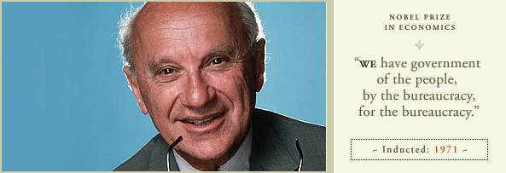
Milton Friedman

Slide 8
Money

Slide 9
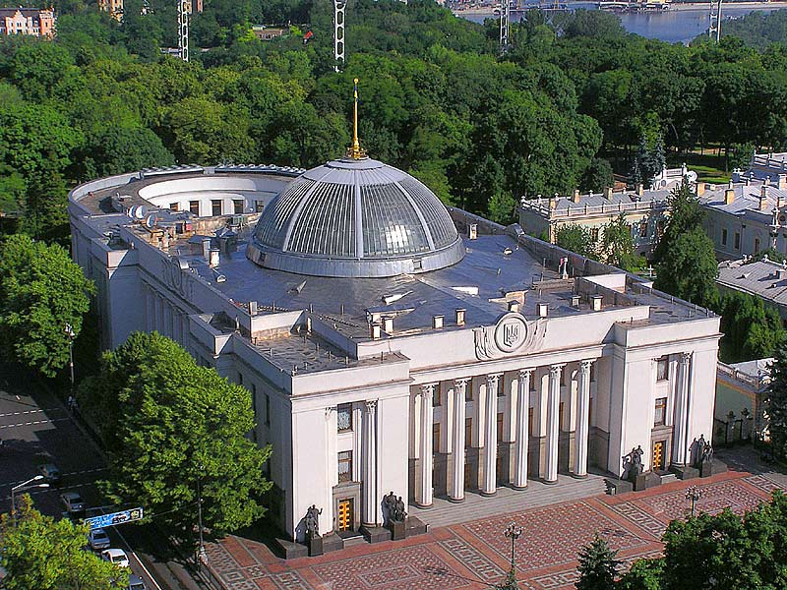

Slide 10
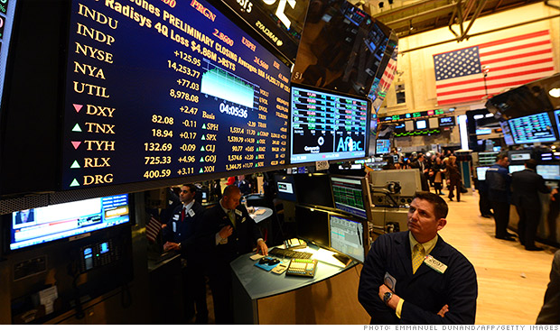

Slide 11
Minimize

Slide 12
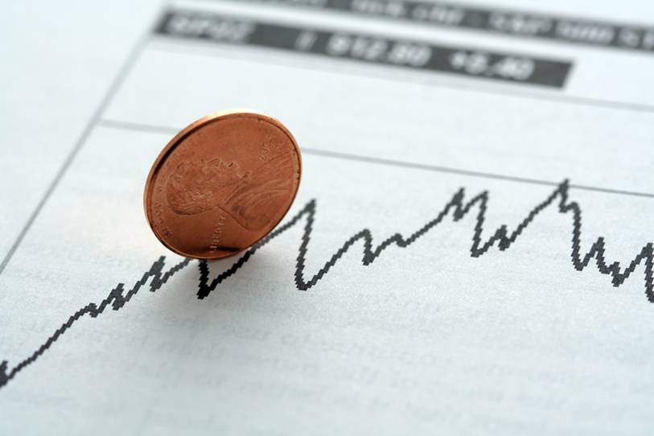

Slide 13
Inflation

Slide 16
Monetarism

